Slide 1
Cassandra and Neo4j DB
By annette chiu and karla dominguez melo
SEE REFERENCES AT LAST SLIDE

Slide 2
What is Cassandra?
A scalable, open-source NoSQL (Not Only SQL) database
Created by Facebook
Open-source since 2008
Peer-to-peer architecture
Replication
Continuous Availability

Slide 3
What is Cassandra?
High Write Throughput
Read efficiency
Fault tolerance
Java
Multi Data Centers support

Slide 4
Cassandra Architecture
The design goal of Cassandra is to handle big data workloads across multiple nodes without any single point of failure. Cassandra has peer-to-peer distributed system across its nodes, and data is distributed among all the nodes in a cluster.
All the nodes in a cluster play the same role. Each node is independent and at the same time interconnected to other nodes.
Each node in a cluster can accept read and write requests, regardless of where the data is actually located in the cluster.
When a node goes down, read/write requests can be served from other nodes in the network.

Slide 5
Partitioning
Nodes are logically structured in Ring Topology.
Hashed value of key associated with data partition is used to assign it to a node in the ring.
Hashing rounds off after certain value to support ring structure.
Lightly loaded nodes moves position to alleviate highly loaded nodes.

Slide 6
Replication
Each data item is replicated at N (replication factor) nodes.
Different Replication Policies
Rack Unaware – replicate data at N-1 successive nodes after its coordinator
Rack Aware – uses ‘Zookeeper’ to choose a leader which tells nodes the range they are replicas for
Datacenter Aware – like Rack Aware but leader is chosen at Datacenter level instead of Rack level.

Slide 7
Gossip Protocols
Network Communication protocols inspired by real life rumor spreading.
Periodic, Pairwise, inter-node communication.
Low frequency communication ensures low cost.
Random selection of peers.
Example – Node A wish to search for pattern in data
Round 1 – Node A searches locally and then gossips with node B.
Round 2 – Node A,B gossips with C and D.
Round 3 – Nodes A,B,C and D gossips with 4 other nodes ……
Round by round doubling makes protocol very robust.

Slide 8
Components of Cassandra
Node: It is the place where data is stored.
Data center: It is a collection of related nodes.
Cluster: A cluster is a component that contains one or more data centers.
Commit log: The commit log is a crash-recovery mechanism in Cassandra. Every write operation is written to the commit log.
Mem-table: A mem-table is a memory-resident data structure. After commit log, the data will be written to the mem-table.
SSTable: It is a disk file to which the data is flushed from the mem-table when its contents reach a threshold value.
Bloom filter: These are nothing but quick, nondeterministic, algorithms for testing whether an element is a member of a set.

Slide 9
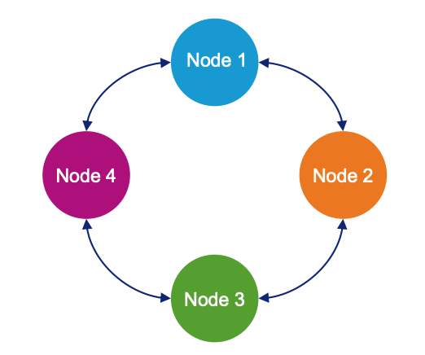
Data replication in Cassandra
In Cassandra, one or more of the nodes in a cluster act as replicas for a given piece of data.

Slide 10
Data Model
Table is a multi dimensional map indexed by key (row key).
Columns are grouped into Column Families.
2 Types of Column Families
Simple
Super (nested Column Families)
Each Column has
Name
Value
Timestamp

Slide 11
Data Model
keyspace
settings
column family
settings
column
name
value
timestamp
* Figure taken from Eben Hewitt’s (author of Oreilly’s Cassandra book) slides.

Slide 12
Keyspace
Keyspace is the outermost container for data in Cassandra. The basic attributes of a Keyspace in Cassandra are:
Replication factor: Number of machines in the cluster that will receive copies of the same data.
Replica placement strategy: The strategy to place replicas in the ring, such as: simple strategy, old network topology strategy, and network topology strategy.
Column families: Container of a collection of rows. Each row contains ordered columns. Column families represent the structure of your data. Each keyspace has at least one and often many column families.
Example syntax to create a Keyspace:

Slide 13
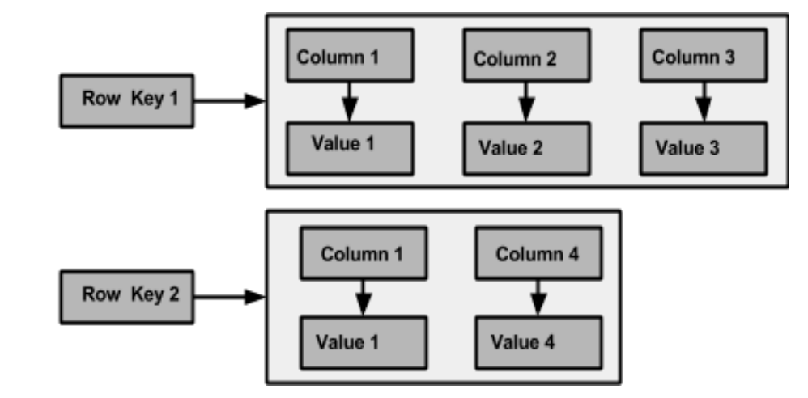
Column family
A Cassandra column family has the following attributes:
keys_cached
rows_cached
preload_row_cache

Slide 14
When should you use Cassandra?
Keeping in mind that the ideal Cassandra application has the following characteristics:
Writes exceed reads by a large margin.
Data is rarely updated
Read Access is by a known primary key.
Data can be partitioned via a key that allows the database to be spread evenly across multiple nodes.
There is no need for joins or aggregates.
Given this, a good example for a Cassandra use case could be to store transactions, such as purchases, or to track movies watched.

Slide 15
Cassandra Query Language
CQL offers a model close to SQL in the sense that data is put in tables containing rows of columns.
The CQL language uses identifiers (or names) to identify tables, columns and other objects.
A few such identifiers, like SELECT or WITH, are keywords. They have a fixed meaning for the language, and most are reserved.

Slide 16
CQL Basics
Create a Keyspace:
CREATE KEYSPACE league WITH REPLICATION = {‘class’:’NetworkTopologyStrategy’, ‘DataCentre1’:3, ‘DataCentre2’: 2};
Remove a keyspace:
DROP KEYSPACE league;
Select a keyspace to operate:
USE league;

Slide 17
CQL Basics
Create a table:
CREATE TABLE teams ( team_name VARCHAR,
player_name VARCHAR,
PRIMARY KEY (team_name, player_name)
);
Alter a table:
ALTER TABLE teams ADD jerseyNumber INT;
Remove a table:
DROP TABLE teams;
Remove all rows in a table:
TRUNCATE TABLE teams;

Slide 18
CQL Basics
Retrieve rows:
SELECT * FROM teams WHERE team_name = ‘Mighty Mutts’ AND player_name = ‘Lucky’;
Insert a row:
INSERT INTO teams (team_name, player_name, jersey) VALUES ('Mighty Mutts',’Felix’,90) IF NOT EXISTS;
Retrieve distinct values:
SELECT DISTINCT team_name FROM league;
Limit the number of rows returned:
SELECT * FROM league LIMIT 1;
Sort the result:
SELECT * FROM league WHERE team_name = ‘Mighty Mutts’ ORDER BY player_name DESC;

Slide 19
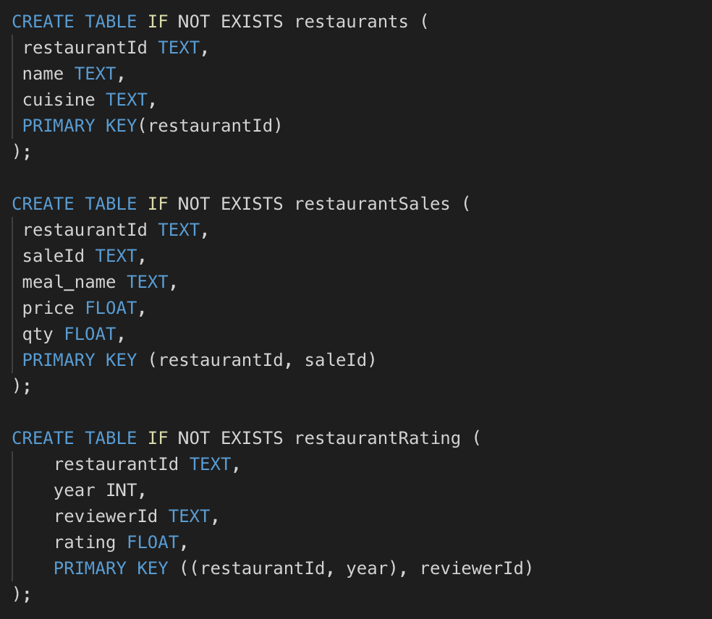
Example dataset with Cassandra

Slide 20
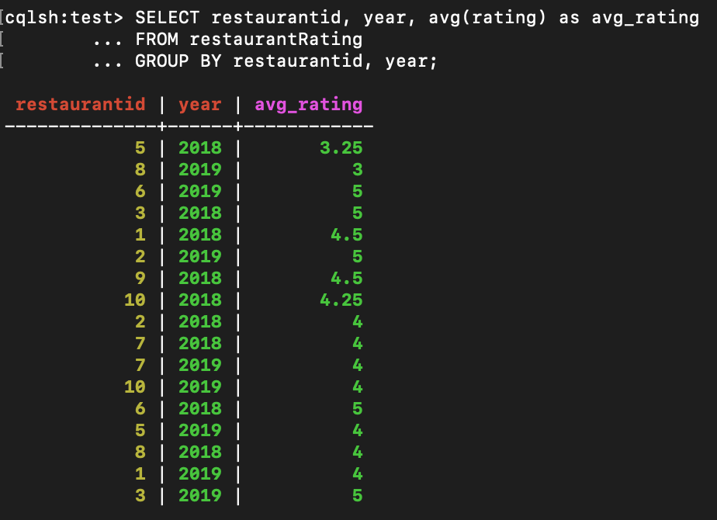
Example CQL Query
We used the built-in aggregate function avg to get the restaurants’ average rating per year.

Slide 21
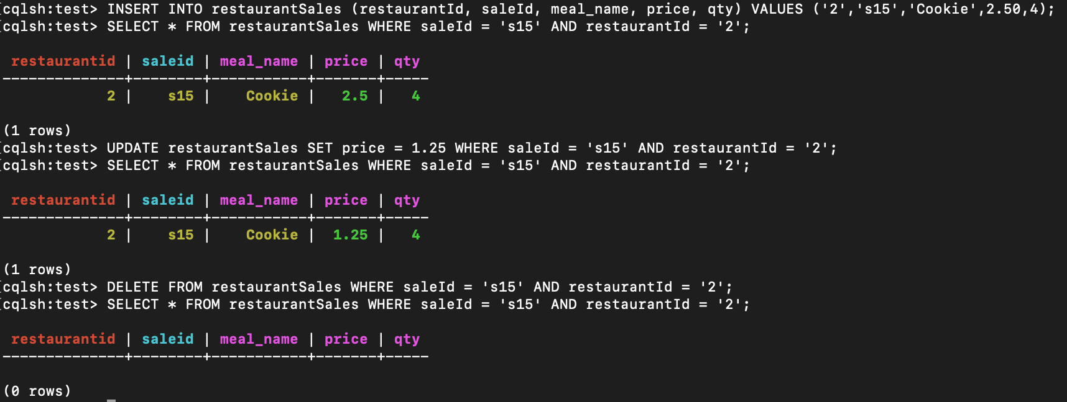
Cassandra CRUD Operations
1) We inserted a new record. (CREATE)
2) we checked if the new record is there by using a SELECT statement. (READ)
3) we changed the value of one of the attributes. (UPDATE)
4) we checked if the record was modified by using a SELECT statement. (READ)
5) we deleted the record. (DELETE)
6) we checked if the record was deleted by using a SELECT statement. (READ)
Neo4j

Slide 22
What is Neo4j?
Neo4j is a native graph database that works with complex and connected data with an graph query language called Cypher. Flat files use table, SQL database use the relational model, and NoSQL databases use a key value model.

Slide 23
Concepts behind the Neo4j?
Nodes
Nodes are often used to represent entities. The simplest possible graph is a single node. Consider the graph below, consisting of a single node.
Labels
Labels are used to shape the domain by grouping nodes into sets where all nodes that have a certain label belongs to the same set.
Relationships
A relationship connects two nodes. Relationships organize nodes into structures, allowing a graph to resemble a list, a tree, a map, or a compound entity
Relationship Types
A relationship must have exactly one relationship type.
Properties
Properties are name-value pairs that are used to add qualities to nodes and relationships.

Slide 24
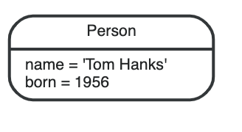
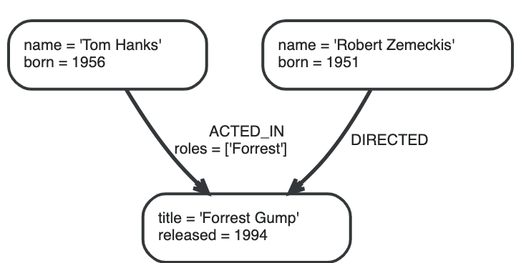
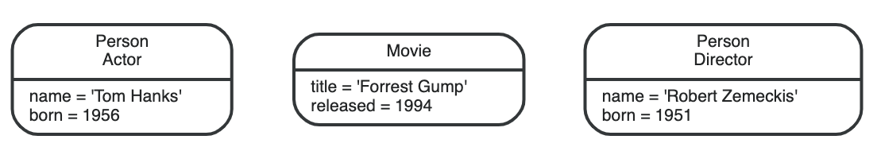
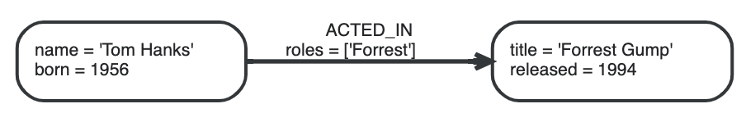
A scenario where you need these databases: Movie
Node
Property: Name, Born, Title, Released
Lables Person, Movie
Relationship Type: ACTED_IN, DIRECTED

Slide 25
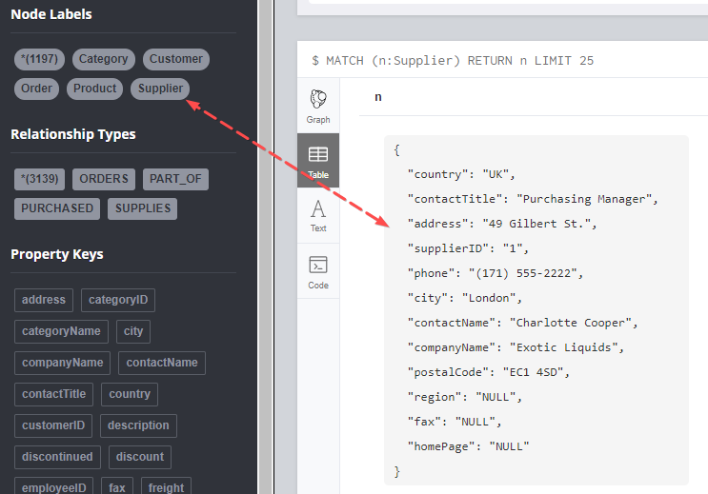
Creating Table with Neo4j

Slide 26
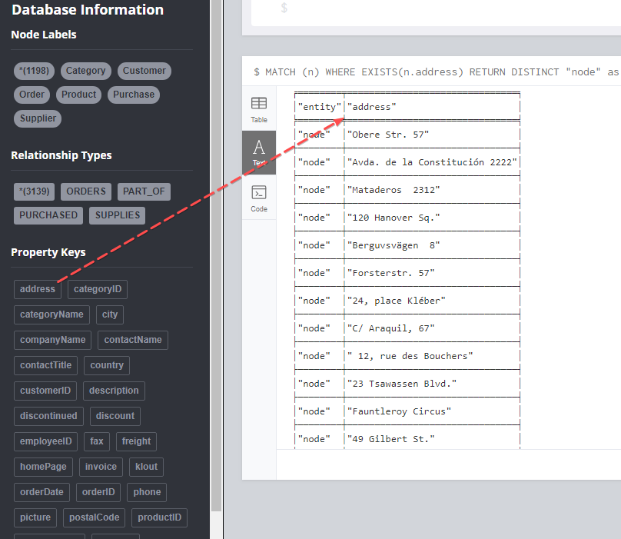
Creating Table with Neo4j

Slide 27
Example dataset with Neo4j
Query 1
10 movies
CREATE (matrix:Movie {title:"The Matrix",released:1997})
CREATE (cloudAtlas:Movie {title:"Cloud Atlas",released:2012})
CREATE (forrestGump:Movie {title:"Forrest Gump",released:1994})
CREATE (AFewGoodMen:Movie {title:”A Few Good Men ",released:1995})
CREATE (JerryMaguire:Movie {title:”Jerry Maguire",released:1996})
CREATE (ReneeZ:Movie {title:”Renee Zellweger ",released:1997})
CREATE (ThatThingYouDo:Movie {title:” That Thing You Do ",released:1998})
CREATE (TheReplacements:Movie {title:”The Replacements ",released:1999})
CREATE (Brooke:Movie {title:”Brooke Langton ",released: 2000})
CREATE (TheBirdcage:Movie {title:”The Birdcage ",released: 2001})
Persons
CREATE (keanu:Person {name:"Keanu Reeves", born:1964})
CREATE (robert:Person {name:"Robert Zemeckis", born:1951})
CREATE (HalleB:Person {name:”Halle Berry", born:1956})
CREATE (JimB:Person {name:”Jim Broadbent", born:1956})
CREATE (TomT:Person {name:"Tom Tykwer", born:1956})
CREATE (DacidMitchell:Person {name:”David Mitchell", born:1956})
CREATE (DacidMitchell:Person {name:”David Mitchell", born:1956})
RELASHIONSHIP acted-IN, DIRECTED
CREATE (tom)-[:ACTED_IN {roles:["Forrest"]}]->(forrestGumpc })
CREATE (tom)-[:ACTED_IN {roles:['Zachry']} ]->(cloudAtlas)
CREATE (robert)-[:DIRECTED]->(forrestGump)
CREATE (HalleB)-[:ACTED_IN {roles:[”Luisa Rey”, ”Luisa Rey”, ”Ovid”]}]-> (CloudAtlas)
CREATE (JimB)-[:ACTED_IN {roles:[”Vyvyab Ayrs”,*Captain Molyneux*]}]->(CloudAtlas)
CREATE (JamesM)-[:ACTED_IN {roles:["Forrest"]}]->(VforVendetta)

Slide 28
Combine statements with UNION
Query 2
MATCH (actor:Person)-[r:ACTED_IN]->(movie:Movie) RETURN actor.name AS name, type(r) AS acted_in, movie.title AS title
UNION
MATCH (director:Person)-[r:DIRECTED]->(movie:Movie) RETURN director.name AS name, type(r) AS acted_in, movie.title AS title
Example dataset with Neo4j

Slide 29
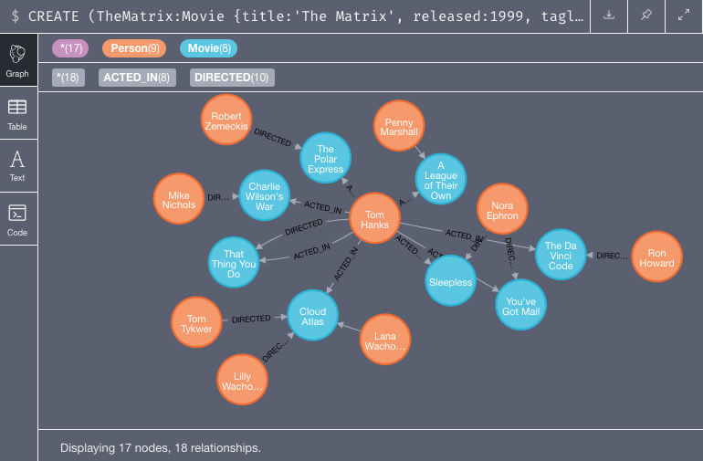

Slide 30
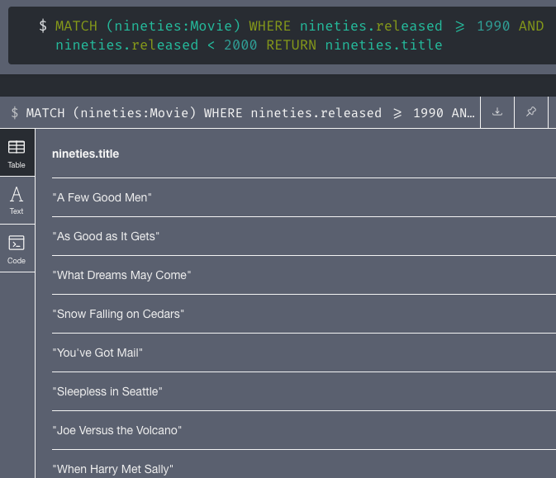
Neo4j Query Operation
Find Movies released in the 1990s….

Slide 31
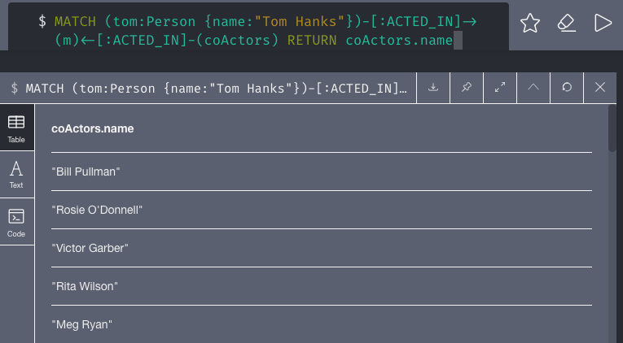
Neo4j Query Operation
List all Tom Hanks movies….

Slide 32
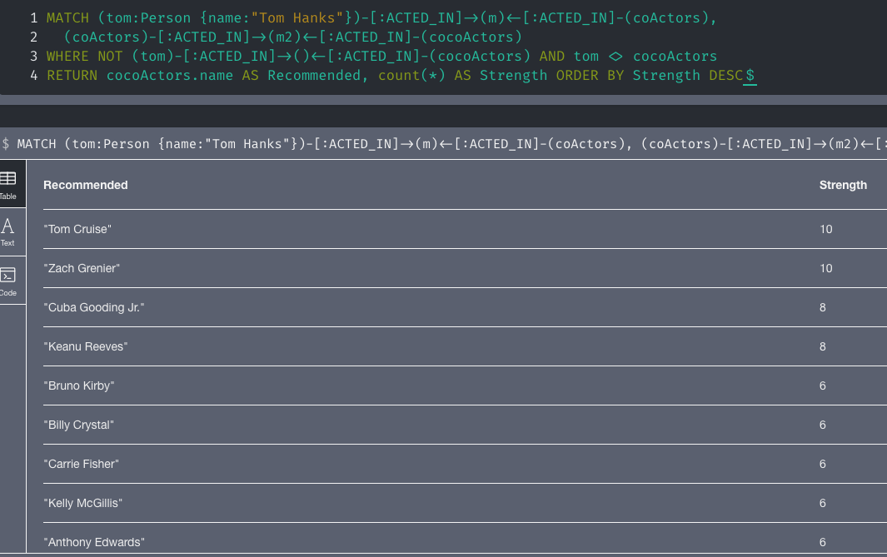
Neo4j Query Operation
Recommend new co-actors for Tom hanks. A basic approach is to
extend Tom hacks co actors, to find co-co-actors who haven’t worked with Tom Hanks

Slide 33
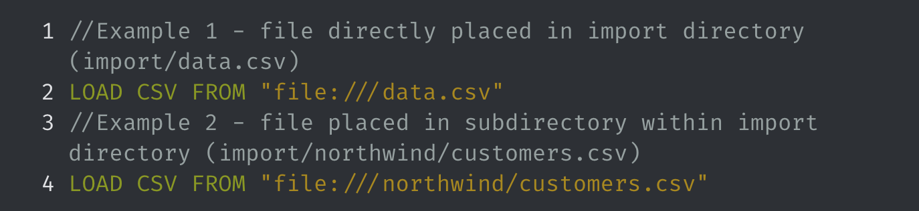
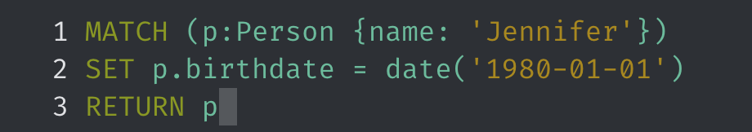
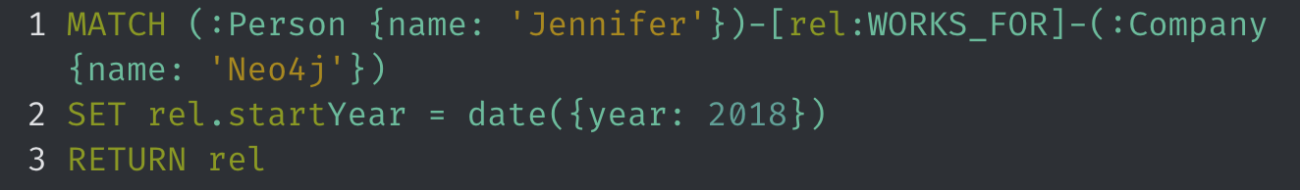
Neo4j CRUD Operations
1) We inserted a new node. (CREATE)
2) Read the csv files (READ)
3) Updating data with Cypher : We use SET to create the new property (UPDATE)
4) Updating data with Cypher: We use SET to create the new relationship type (UPDATE)
5) Delete the Node with the DELETE (DELETE)

Slide 34
Comparison with SQL
SQL | Cassandra and Neo4j
SQL deals with structured data. | Cassandra and Neo4j deals with unstructured data.
It has a fixed schema. | Cassandra and Neo4j has a flexible schema.
In SQL, a table is an array of arrays. (ROW x COLUMN) | Cassandra, a table is a list of “nested key-value pairs”. (ROW x COLUMN key x COLUMN value). In Neo4j, a graph is a collection of nodes and edges where each node is used to represent an entity and each edge describes the relationship between entities.
Database is the outermost container that contains data corresponding to an application. | In Cassandra, Keyspace is the outermost container that contains data corresponding to an application.
Tables are the entities of a database. | Tables or column families are the entity of a keyspace. A node represents an entity in Neo4j.
Row is an individual record in SQL. | Row is a unit of replication in Cassandra
Column represents the attributes of a relation. | Column is a unit of storage in Cassandra
SQL supports the concepts of foreign keys, joins. | Relationships are represented using collections in Cassandra. Neo4j stores relationships and connections as edges.

Slide 35
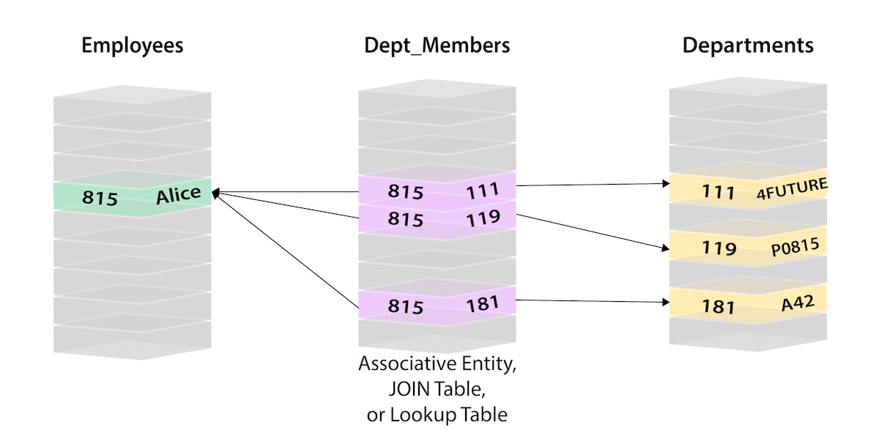
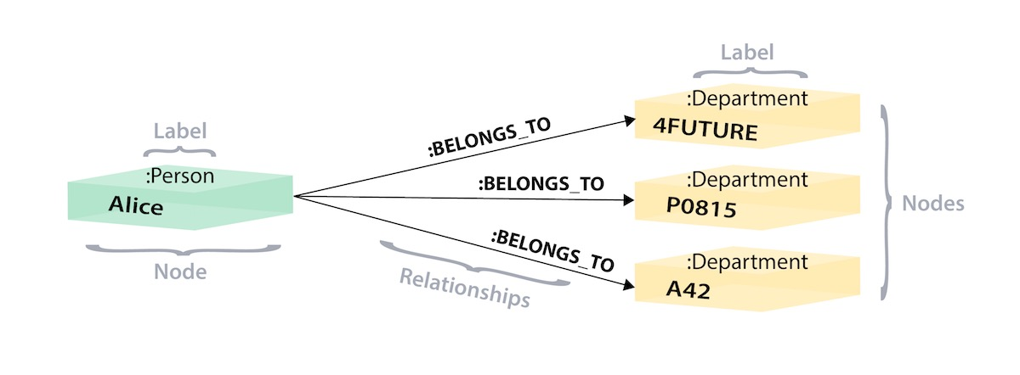
Comparison with SQL
Relational Model
Graph

Slide 36













Who uses Cassandra?
Who uses Neo4j?
… and more!

Slide 37
References
http://www.andrew.cmu.edu/course/14-736/applications/ln/Cassandra.pdf
https://www.javatpoint.com/rdbms-vs-cassandra
https://www.tutorialspoint.com/cassandra/
https://www.slideshare.net/gokhanatil/introduction-to-cassandra-88223524
https://neo4j.com/docs/getting-started/current/graphdb-concepts/
https://neo4j.com/graphgist/how-to-compose-large-statements

